Slide 1


IOT BASED SMART HELMET AND ACCIDENT IDENTIFICATION SYSTEM
PRESENTED BY 510919106002 – ARUN KUMAR V 510919106006 – ENBA KUMAR R 510919106015 – SANTHOSH R 510919106020 – UVENDHAN H
GUIDED BY MRS.P.ARTHI ASSISTANT PROFESSOR DEPARTMENT OF ELECTRONICS AND COMMUNICATION

Slide 2
OVERVIEW
Abstract
Introduction
Literature Survey
Existing system and Drawbacks
Proposed System
Proposed System Advantage
Block / circuit Diagram
Block Diagram Explanation
Hardware & Software Requirement
Conclusion
Reference

Slide 3
ABSTRACT
The number of fatal traffic accidents continues to rise as a direct result of riders' refusal to wear helmets and the pervasive use of alcohol while driving.
The overarching goal of this project work is to reduce the number of incidents caused by reckless behaviours such driving under the influence, driving when fatigued, driving while distracted, and speeding.
Riders will be required to wear the high-tech helmet, which is outfitted with an Zigbee transmitter, a mems sensor, and an Arduino and IoT Node MCU.
An alcohol sensor checks the breath of the rider to avoid drunk driving, and the bike is disabled if the user is inebriated or without wearing a helmet.
If the rider was involved in an accident, a text message containing the rider's current position is sent to the mobile phone to the registered emergency contact information, with the help of the GSM module.

Slide 4
INTRODUCTION
Bike accidents are on the rise, and as a result, many lives are being lost.
The risk of head injury in the event of a bike accident may be reduced by wearing a helmet.
It is estimated that 1.2 million lives are lost on the world's roadways each year.
Even though hospitals now provide ambulance services, the fatality rate has not decreased.
30% of accidents are attributed to not wearing a helmet properly.

Slide 5
According to information gathered by the World Health Organization (WHO), a helmet worn by a motorcyclist may save as many as 70 percent of serious injuries and 40 percent of fatalities resulting from collisions.
Our The main intent is:
To develop a prototype that provides safety to motorcycle riders.
To design a model that reduces the road accidents due to Drunk and drive, not wearing helmet.
To design system that alerts the family members/friends by giving information about the accidents.
To design system that promotes wearing of helmet, which can decrease traumatism from the impact and may save a life.

Slide 6
LITERATURE SURVEY
SI NO. | TITLE | JOURNAL NAME | AUTHOR | YEAR OF PUBLICATION | TECHNIQUES USED | DRAWBACKS
1 | Rider Safety System using IoT for Two-Wheelers | International conference on Smart Systems and Inventive Technology by IEEE explore | RAMU.A , et.al | 2023 | i.)The method based on RF transmission that prevents the motorcycle from igniting the vehicle unless the rider wears a protective helmet ii.)The circuit is low power consumption, low complexity, and low cost, this system might be used on road transport vehicles | i.) The block diagram must be explained in two sections – Helmet unit , Bike unit.
2 | IoT based Smart Communication System for Accident Prevention | International Conference on Smart Systems and Inventive Technology by IEEE explore | Selvam.N , et.al | 2023 | i.) The encoder for an IOT-based splendid correspondence system for accident neutralisation would be created using data from the sensors presented in the Structure. | The circuit design are all placed in bike unit only. Only IR transmitter is placed in Helmet sensor.

Slide 7
SI NO. | TITLE | JOURNAL NAME | AUTHOR | YEAR OF PUBLICATION | TECHNIQUES USED | DRAWBACKS
3.) | ADVANCED SMART HELMET AND AUTOMATIC ACCIDENT ALERT SYSTEM | Dogo Rangsang Research Journal | S.TULASI, et.al | 2023 | i.)MQ-7 sensor is used for alcohol detection and it can sense carbon mono oxide gas in environment | It can be implemented in other mode of vehicles.
4.) | IoT based Smart Helmet System for Accident Prevention | International Conference on Edge Computing and Applications | S. Johnpaul | 2022 | i.)The Arduino Uno microcontroller is used for processing both helmet unit and bike unit | The micro controller has limited scope.
5.) | Smart Bike Helmet with Vehicle Tracking System using Arduino | International Conference on Edge Computing and Applications | Priya.C | 2022 | i.)The implementation of bike and helmet unit for bike riders are using embedded technology | The operating range of the GPS limited by ISP of the GSM.

Slide 8
EXISTING SYSTEM :
The sensor checks if the rider is drunk.
If the rider is drunk then the ignition of the bike is avoided and the hence not letting the rider to ride the bike.
This prototype uses Memes sensors to detect a crash or accidents and the communication hardware is used to automatically notify a predefined emergency contact.
The other system is to control the speed in which the biker is going on. The helmet is fixed with all the components and sensors that read the speed of the bike and accordingly instruct the rider to reduce or increase the speed based on the obstacles ahead the bike.

Slide 9
DRAWBACKS OF EXISTING SYSTEM:
Rider does not wear helmet in regions where traffic checking is not done.
No security to the helmet.
Battery rechargeability problem in between riding.
Difficulty of implementation of this system in day-today-life by Government .

Slide 10
PROPOSED SYSTEM :
In this system, The User needs to wear the helmet in order to start the engine.
we use, an Arduino UNO micro controller interfaced with alcohol sensor and it is used to monitor breath of the rider and constantly sends Output signals to micro controller.
If the alcohol is detected the system locks the engine.
The system also sends a Accident Alert message including the latitude and longitude location of the incident using GSM & GPS Module.
It uses a MEMS sensor to detect an accident.
It also has a temperature sensor which notifies when the helmet gets heated up to avoid the circuit damage.
We use RF ID reader for security purpose of the helmet.

Slide 11
PROPOSED SYSTEM SOLUTIONS :
Safety to the Rider’s life.
Security to the helmet.
The bike Engine Won’t get activated Unless the helmet is worn properly.
Prevention of drunk & drive.
Over heat protection to the helmet unit.
Accident Alert to the Rider’s friends & family.

Slide 12
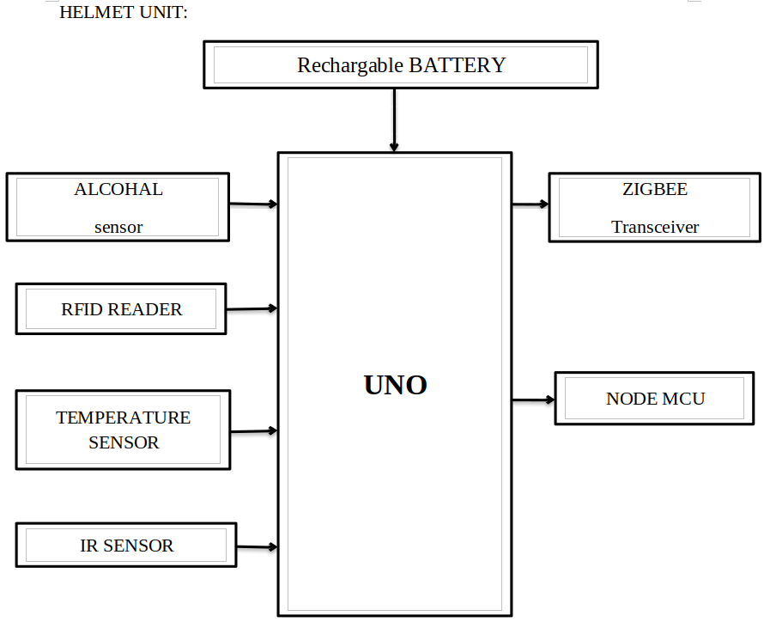
BLOCK DIAGRAM :

Slide 13
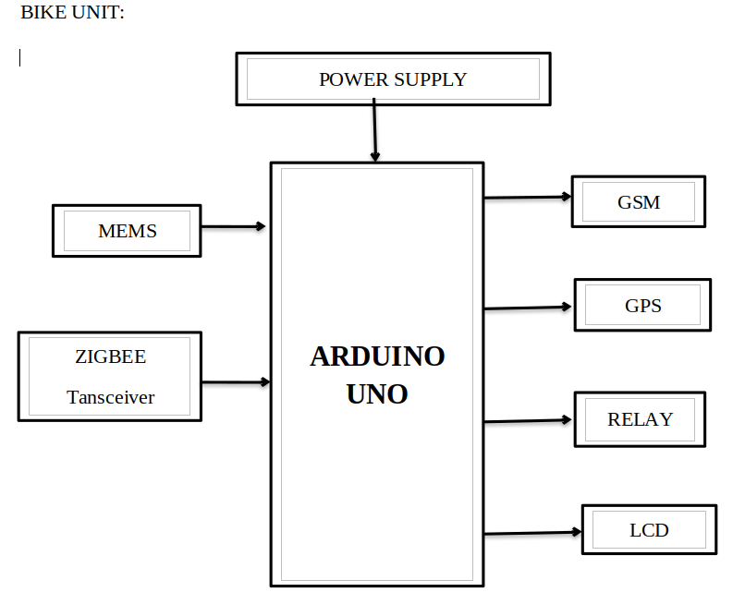
BLOCK DIAGRAM :

Slide 14
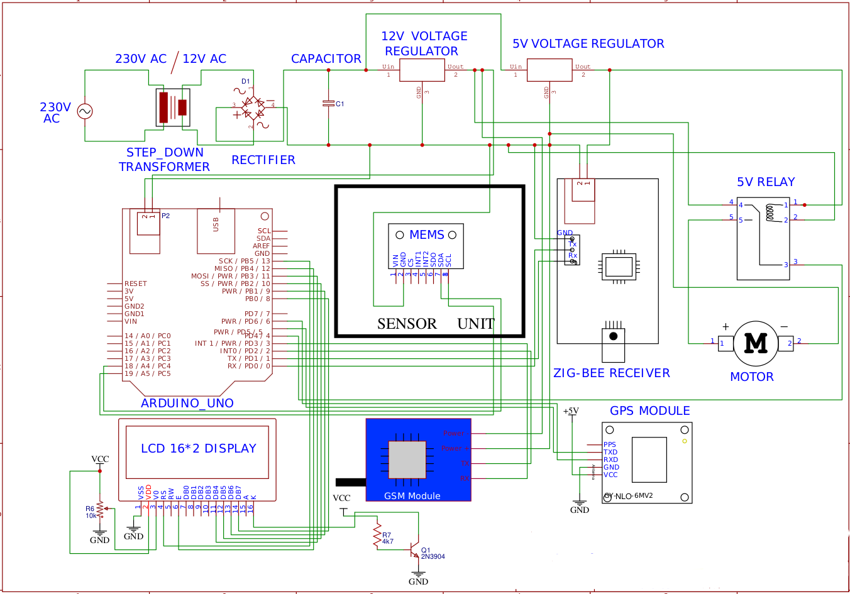
Bike Unit-Circuit diagram

Slide 15
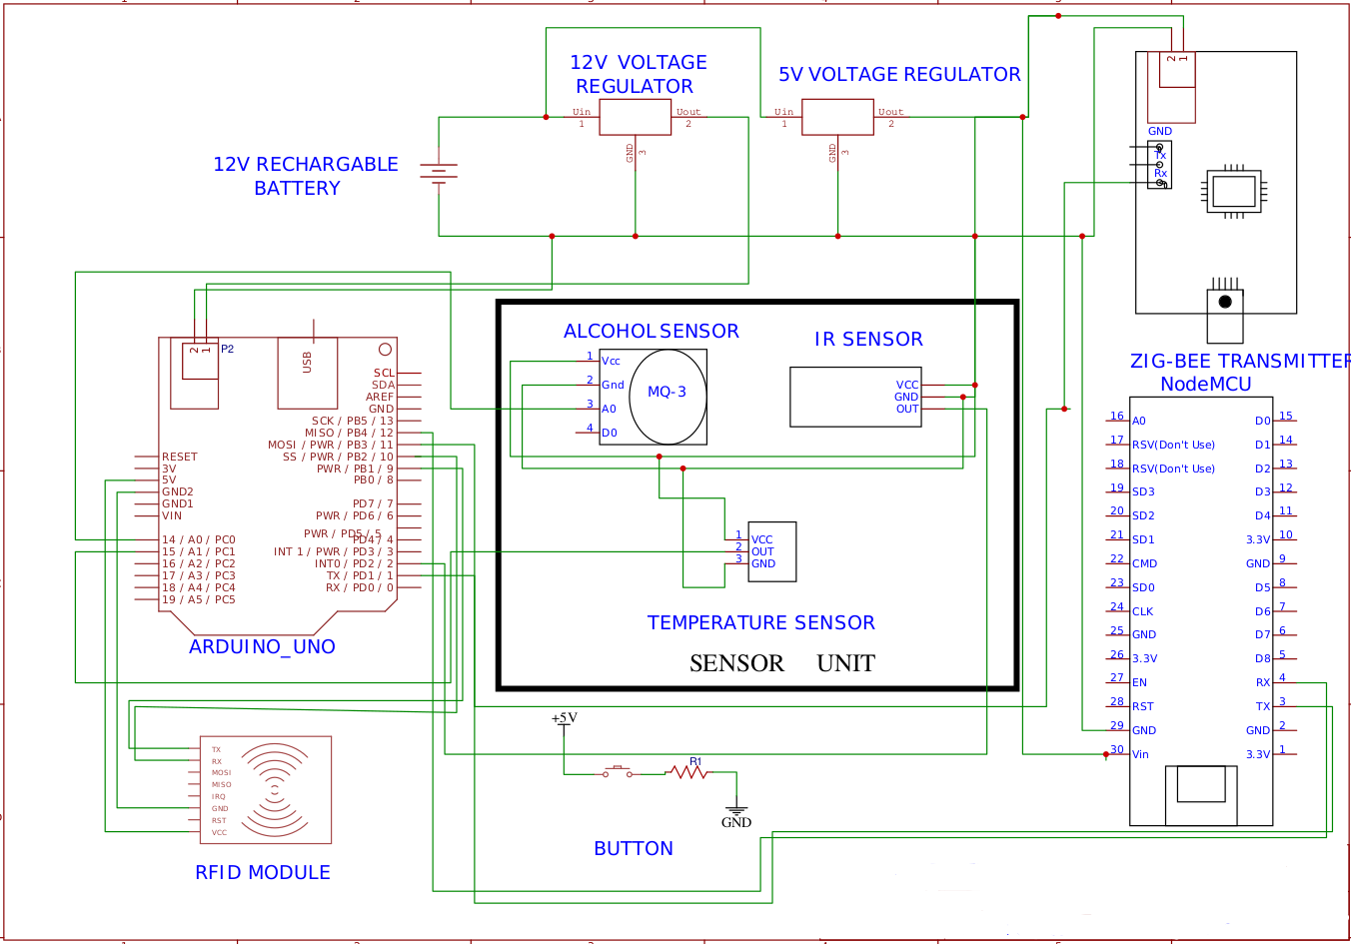
Helmet Unit-Circuit diagram

Slide 16
BLOCK DIAGRAM-EXPLANATION
ARDUINO UNO
It's a microcontroller. Here we are going to use "TheATmega48PA/88PA/168PA/328P". Which is a low-power CMOS 8-bit.
Microcontroller with 4/8/16/32K Bytes In-System Programmable Flash based on the AVR enhanced RISC architecture. By executing powerful instructions in a single clock cycle
The ATmega48PA/88PA/168PA/328P achieves throughputs approaching 1 MIPS per MHz allowing the system designer to optimize power consumption versus processing speed.

Slide 17
OPERATING RANGE:
Operating Temperature.................................. -55°C to +125°C
Storage Temperature ..................................... -65°C to +150°C
The voltage on any Pin except RESET
with respect to Ground ................................-0.5V to VCC+0.5V
The voltage on RESET with respect to Ground......-0.5V to +13.0V
Maximum Operating Voltage ............................................ 6.0V
DC Current per I/O Pin ............................................... 40.0 mA
DC Current VCC and GND Pins................................ 200.0 mA

Slide 18
GSM
GSM or Global System for Mobile Communications is the most popular wireless cellular communication technique, used for public communication.
The GSM standard was developed for setting protocols for second-generation (2G) digital cellular networks.
In simple words, It's a device with helps to hold the simcard like a phone.
Here the GSM provides internet to the "GPS" and helps to transmit the received/stored data to the "IOT" devices.
GPS
There are many vendors who manufacture GPS with their own specifications.
Here we might be using a NEO-6M GPS Module.

Slide 19
GPS-OPERATING RANGE:
This module has an external antenna and built-in EEPROM.
Interface: RS232 TTL
Power supply: 3V to 5V
Default baud rate: 9600 bps. (Bit per Second)

Slide 20
RELAY
A Relay is a simple electromechanical switch. While we use normal switches to close or open a circuit manually.
A Relay is also a switch that connects or disconnects two circuits. But instead of a manual operation.
A relay uses an electrical signal to control an electromagnet, which in turn connects or disconnects another circuit.
The relay is connected to the self-starter switch ( for igniting the motor ).

Slide 21
MOTOR
The motor here represent the Engine of the bike. The ON/OFF signals are given from the relay form the micro-controller.
Here we use DC motar which range form 5v~12v.
Speeds from 0 to 14,000 rpm.
Continuous motor torque - 0.36 to 160 mNm.

Slide 22
MEMS SENSOR
The mems sensor is used as a Level gauging. AKA "The SCP1000 SERIES" (120 kPa) ABSOLUTE PRESSURE SENSOR.
Features
• 30 kPa - 120 kPa measuring range
• Single +2.4 … 3.3 V supply
• Four measuring modes plus power down mode
• On-chip temperature measurement
• Fully calibrated and compensated component
• Standard digital output: SPI or I2 C1
• Small package size with optional 2 sealing gasket. Diameter 6.1 mm, height 1.7 mm
• Proof pressure 2.0 MPa
• Pb-free solderable component & RoHS_x005F_x0002_compatible.
Which is used to detect the fall in an accident and its connected to the arduino uno.

Slide 23
ZIGBEE TRANSCEIVER
The AKA "Xbee" shield allows an Arduino board to communicate wirelessly using Zigbee. It is based on the Xbee module from MaxStream.
The module can communicate up to 100 feet indoors or 300 feet outdoors (with line-of-sight).
It can be used as a serial/usb replacement or you can put it into a command mode and configure it for a variety of broadcast and mesh networking options.
It also provides female pin headers for use of digital pins 2 to 7 and the analog inputs, which are covered by the shield (digital pins 8 to 13 are not obstructed by the shield).
It is used to receive the transmitted signals from the "Helmet Unit".
.

Slide 24
NODE MCU
The NodeMCU ESP8266 development board comes with the ESP-12E module containing the ESP8266 chip having Tensilica Xtensa 32-bit LX106 RISC microprocessor.
This microprocessor supports RTOS and operates at 80MHz to 160 MHz adjustable clock frequency. NodeMCU has 128 KB RAM and 4MB of Flash memory to store data and programs.
Its high processing power with in-built Wi-Fi / Bluetooth and Deep Sleep Operating features make it ideal for IoT projects.
NodeMCU can be powered using a Micro USB jack and VIN pin (External Supply Pin). It supports UART, SPI, and I2C interface.
ITS connected to the IOT ,which sends the Alert messages.

Slide 25
Grove - Alcohol Sensor:
Grove - Alcohol Sensor is a complete alcohol sensor module for Arduino or Seeeduino.
It is built with MQ303A semiconductor alcohol sensor.
It has good sensitivity and fast response to alcohol.
It is suitable for making Breathalyzer.
This rove implements all the necessary circuitry for MQ303A like power conditioning and heater power supply.
This output voltage inversely proportional to the alcohol concentration in air.

Slide 26
WORKING RANGE:
Input Voltage: 5V
Working Current: 120mA
Detectable Concentration: 20-1000ppm
Grove Compatible connector
Highly sensitive to alcohol.
Fast response and resumes quickly after alcohol exposure.
Long life.
Compact form factor.

Slide 27
POWER SUPPLY
The power supply here represents the bike battery. which helps to power up all the bike units like " MEMS, ZIGBEE TRANSCEIVER, GSM, GPS, RELAY, NODE MCU and MOTOR.
The power supply ranges is from 12V DC to 24V as the bike model, which might be stepped down as a requirement to the components.
The power supply unit consist of a step-down Transformer 230v-0-12v.
A fullBridge rectifier to convert AC to DC.

Slide 28
HARDWARE REQUIREMENTS:
Power supply unit.
Arduino Uno Microcontroller.
MEMS sensor.
Temperature sensor.
Alcohol Sensor.
Relay.
Motor.
Zigbee Transceiver.
Rechargable battery.
RFID.
Node MCU.
Debuging cable.
LCD.
GSM.
GPS.

Slide 29
SOFTWARE REQUIREMENTS: ARDUINO IDE ( any latest version is preferd )
PROGRAMMING LANGUAGE :
EMBEDDED C

Slide 30
Conclusion:
There are things that can be improved in the helmet and bike unit. Which Might not be an effective way do it in terms of cost in Todays Date. The Helmet can be further improved by adding a Flexible solar pannel upon the helmet itself. Which Will be very helpfull for charging the battery unit of the helmet even while riding the bike. MeanWhile the Flexible solar pannel itself cost Around more than 3K. More over , The Circuit Diagram can be further processed to a Single board PCB. Which is more efficient and Convinent Design to the helmet and Bike unit.

Slide 31
REFERENCE:
ADVANCED SMART HELMET AND AUTOMATIC ACCIDENT ALERT SYSTEM 2023.
IoT_based_Smart_Communication_System_for_Accident_Prevention 2023
IoT_based_Smart_Helmet_System_for_Accident_Prevention 2022
Smart_Bike_Helmet_with_Vehicle_Tracking_System_using_Arduino 2022

Slide 32
QUESTIONS ?

Slide 33
THANK YOU

